Slide 1
CREDIT CARD FRAUD DETECTION USING PREDICTIVE MODELLING

Slide 2
Index :
Abstract
Introduction
Problem Statement
Existing system
Disadvantages
Proposed System
Advantages
SRS

Slide 3
Abstract:-
Billions of dollars of loss are caused every year by fraudulent credit card transactions. The design of efficient fraud detection algorithms is key for reducing these losses, and more and more algorithms rely on advanced machine learning techniques to assist fraud investigators. The design of fraud detection algorithms is however particularly challenging due to the non-stationary distribution of the data, the highly unbalanced classes distributions and the availability of few transactions labeled by fraud investigators. At the same time public data are scarcely available for confidentiality issues, leaving unanswered many questions about what is the best strategy. In this thesis we aim to provide some answers by focusing on crucial issues such as: i)

Slide 4
why and how under sampling is useful in the presence of class imbalance (i.e. frauds are a small percentage of the transactions), ii) how to deal with unbalanced and evolving data streams (non-stationarity due to fraud evolution and change of spending behavior), iii) how to assess performances in a way which is relevant for detection and iv) how to use feedbacks provided by investigators on the fraud alerts generated. Finally, we design and assess a prototype of a Fraud Detection System able to meet real-world working conditions and that is able to integrate investigators’ feedback to generate accurate alerts.
Index Terms— Hidden Markov Model, credit card, fraud detection, online shopping, e-commerce (HMM)

Slide 5
Introduction
The online shopping growing day to day. Credit cards are used for purchasing goods and services with the help of virtual card and physical card where as virtual card for online transaction and physical card for offline transaction. In a physical-card based purchase, the cardholder presents his card physically to a merchant for making a payment. To carry out fraudulent transactions in this kind of purchase, an attacker has to steal the credit card. If the cardholder does not realize the loss of card, it can lead to a substantial financial loss to the credit card company. In online payment mode, attackers need only little information for doing fraudulent transaction (secure code, card number, expiration date etc.). In this purchase method, mainly transactions will be

Slide 6
done through Internet or telephone. To commit fraud in these types of purchases, a fraudster simply needs to know the card details. Most of the time, the genuine cardholder is not aware that someone else has seen or stolen his card information. The only way to detect this kind of fraud is to analyse the spending patterns on every card and to figure out any inconsistency with respect to the “usual” spending patterns. Fraud detection based on the analysis of existing purchase data of cardholder is a promising way to reduce the rate of successful credit card frauds. Since humans tend to exhibit specific behavioristic profiles, every cardholder can be represented by a set of patterns containing information about the typical purchase category, the time since the last purchase, the amount of money spent, etc. Deviation from such patterns is a potential threat to the system

Slide 7
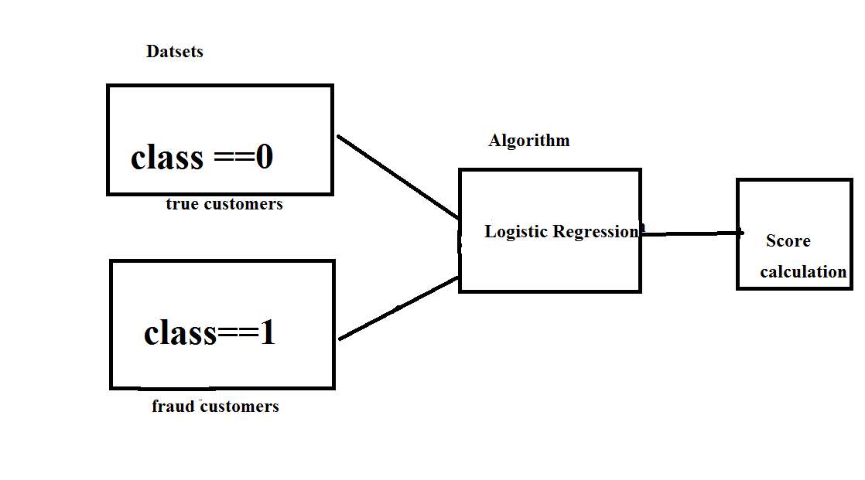
Design:

Slide 8
Problem statement
Credit card fraud stands as major problem for word wide financial institutions. Annual lost due to it scales to billions of dollars. We can observe this from many financial reports. Such as (Bhattacharyya et al., 2011) 10th annual online fraud report by Cyber Source shows that estimated loss due to online fraud is $4 billion for 2008 which is 11% increase than $3.6 billion loss in 2007and in 2006, fraud in United Kingdom alone was estimated to be £535 million in 2007 and now costing around 13.9 billion a year (Mahdi et al., 2010). From 2006 to 2008, UK alone has lost £427.0 million to £609.90 million due to credit and debit card fraud (Woolsey &Schulz, 2011). Although, there is some decrease in such losses after implementation of

Slide 9
detection and prevention systems by government and bank, card-not-present fraud losses are increasing at higher rate due to online transactions. Worst thing is it is still increasing un-protective and un-detective way.
Over the year, government and banks have implemented some steps to subdue these frauds but along with the evolution of fraud detection and control methods, perpetrators are also evolving their methods and practices to avoid detection. Thus an effective and innovative methods need to be develop which will evolve accordingly to the need.

Slide 10
Existing system
This was on k-means Algorithm implementation, Only the two features with the most variance were used to train the model. The model was set to have 2 clusters, 0 being non-fraud and 1 being fraud. We also experimented with different values for the hyper parameters, but they all produced similar results. Changing the dimensionality of the data (reducing it to more dimensions than 2) also made little difference on the final values

Slide 11
Disadvantages :
The Clustering doesn’t produce the less accuracy when compared to Regression methods in scenarios like credit card fraud detection. Comparatively with other algorithms k-means produce less accurate scores in prediction in this kind of scenarios

Slide 12
Proposed System:
Our goal is to implement machine learning model in order to classify, to the highest possible degree of accuracy, credit card fraud from a dataset gathered from Kaggle. After initial data exploration, we knew we would implement a logistic regression model for best accuracy reports.
Logistic regression, as it was a good candidate for binary classification. Python sklearn library was used to implement the project, We used Kaggle datasets for Credit card fraud detection, using pandas to data frame for class ==0 for no fraud and class==1 for fraud, matplotlib for plotting the fraud and non fraud data, train_test_split for data extraction (Split arrays or matrices into random train and test subsets) and used Logistic Regression machine learning algorithm for fraud detection and print predicting score according to the algorithm. Finally Confusion matrix was plotted on true and predicted.

Slide 13
Advantages:
The results obtained by the Logistic Regression Algorithm is best compared to any other Algorithms.
The Accuracy obtained was almost equal to cent percent which proves using of Logistic algorithm gives best results.
The plots that were plotted according to the proper data that is processed during the implementation

Slide 14
Hardware Requirements:
• RAM: 4GB and Higher
• Processor: Intel i3 and above
• Hard Disk: 500GB: Minimum

Slide 15
Software Requirements:
OS: Windows or Linux
Python IDE : python 2.7.x and above
Pycharm IDE Required
Setup tools and pip to be installed for 3.6 and above
Language : Python Scripting

Slide 16
modules

Slide 17
Pandas
Pandas is an open-source, Python library providing high-performance, easy-to-use data structures and data analysis tools for the Python programming language. Python with Pandas is used in a wide range of fields including academic and commercial domains including finance, economics, Statistics, analytics, etc.

Slide 18
Numpy
NumPy, which stands for Numerical Python, is a library consisting of multidimensional array objects and a collection of routines for processing those arrays. Using NumPy, mathematical and logical operations on arrays can be performed. This tutorial explains the basics of NumPy such as its architecture and environment. It also discusses the various array functions, types of indexing, etc. An introduction to Matplotlib is also provided. All this is explained with the help of examples for better understanding.

Slide 19
Matplotlib
matplotlib is probably the single most used Python package for 2D-graphics. It provides both a very quick way to visualize data from Python and publication-quality figures in many formats. We are going to explore matplotlib in interactive mode covering most common cases.

Slide 20
Sklearn
There are several Python libraries which provide solid implementations of a range of machine learning algorithms. One of the best known is Scikit-Learn, a package that provides efficient versions of a large number of common algorithms. Scikit-Learn is characterized by a clean, uniform, and streamlined API, as well as by very useful and complete online documentation. A benefit of this uniformity is that once you understand the basic use and syntax of Scikit-Learn for one type of model, switching to a new model or algorithm is very straightforward.
This section provides an overview of the Scikit-Learn API; a solid understanding of these API elements will form the foundation for understanding the deeper practical discussion of machine learning algorithms and approaches in the following chapters.
SAFARI
Learn faster. Dig deeper. See farther.
Join Safari. Get a free trial today and find answers on the fly, or master something new and useful.
Learn more
We will start by covering data representation in Scikit-Learn, followed by covering the Estimator API, and finally go through a more interesting example of using these tools for exploring a set of images of hand-written digits.

Slide 21
Architecture

Slide 22
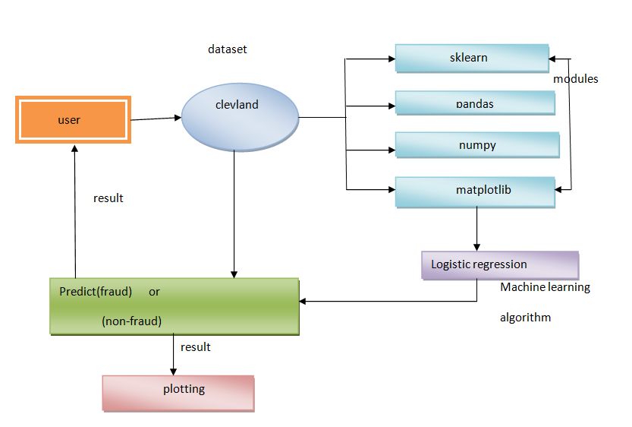

Slide 23
UMLS ON CREDITCARD FRAUD DETECTION

Slide 24
Class diagram:

Slide 25
Activity diagram
Activity diagrams are graphical representations of Workflows of stepwise activities and actions with support for choice, iteration and concurrency. In the Unified Modeling Language, activity diagrams can be used to describe the business and operational step-by-step workflows of components in a system. An activity diagram shows the overall flow of control.

Slide 27
Sequence diagram:
A sequence diagram in Unified Modeling Language (UML) is a kind of interaction diagram that shows how processes operate with one another and in what order. It is a construct of a Message Sequence Chart. A sequence diagram shows, as parallel vertical lines ("lifelines"), different processes or objects that live simultaneously, and, as horizontal arrows, the messages exchanged between them, in the order in which they occur. This allows the specification of simple runtime scenarios in a graphical manner.

Slide 28
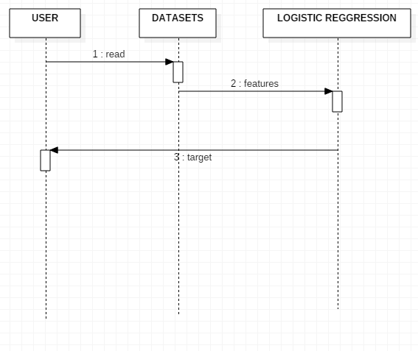

Slide 29
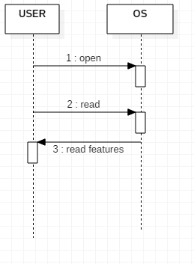

Slide 30
Component diagram

Slide 31
Deployement diagram:

Slide 32
Dataset sreenshots

Slide 33
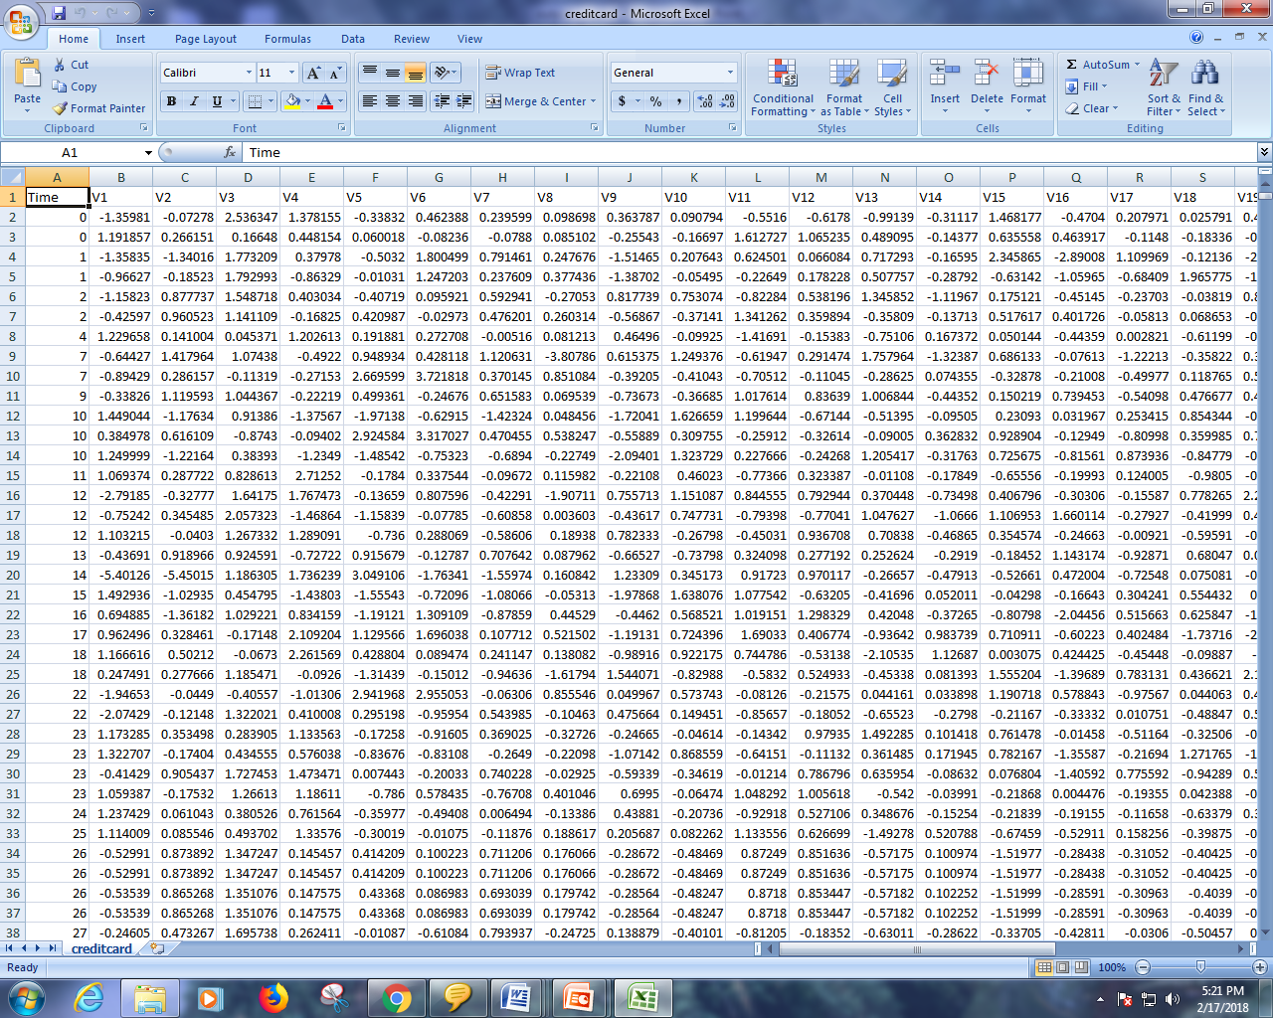

Slide 34
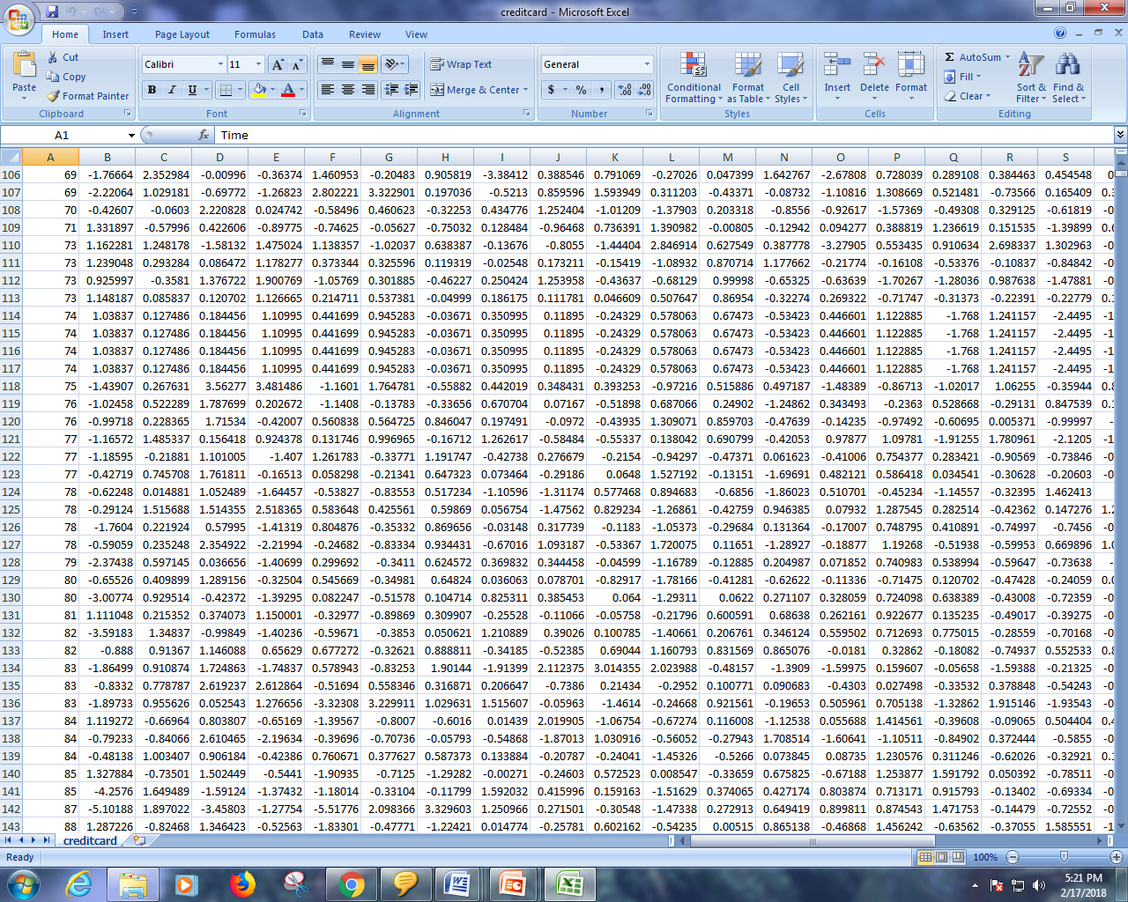

Slide 35
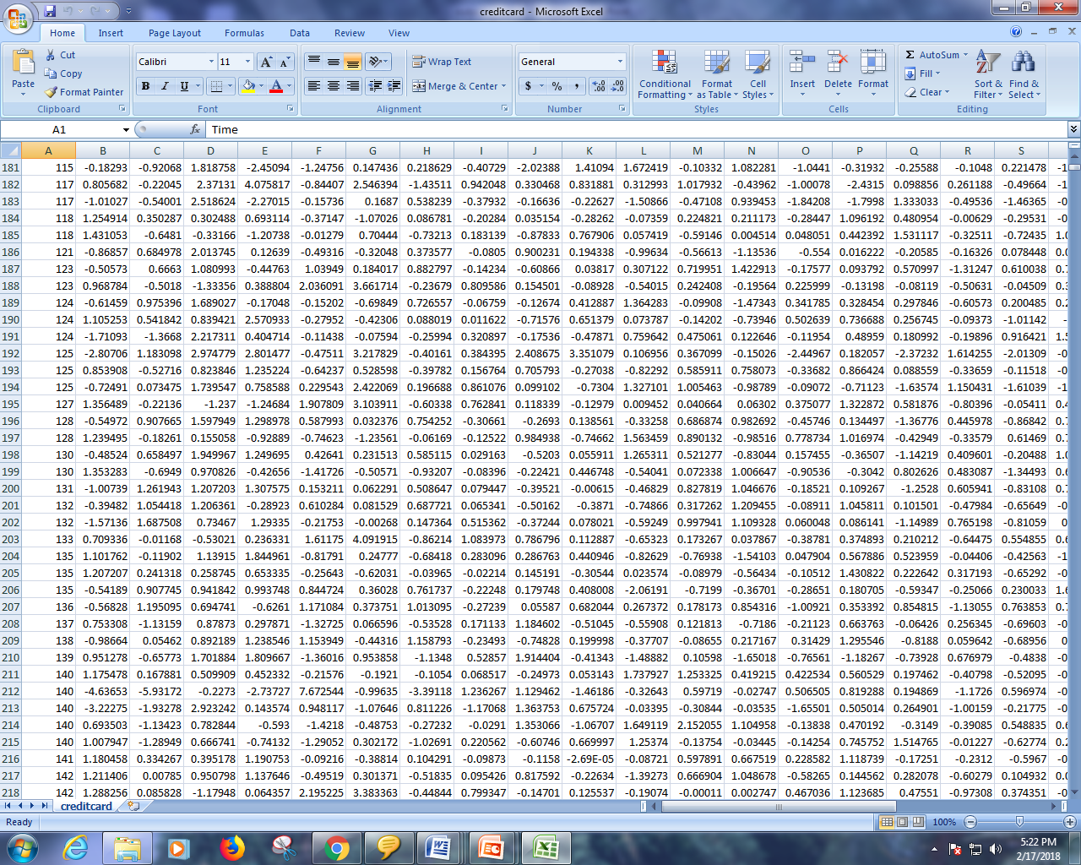

Slide 36
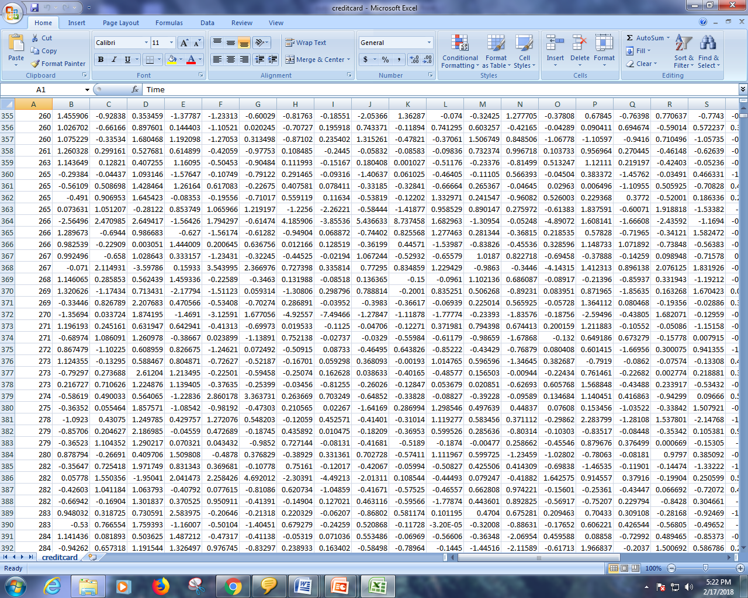

Slide 37
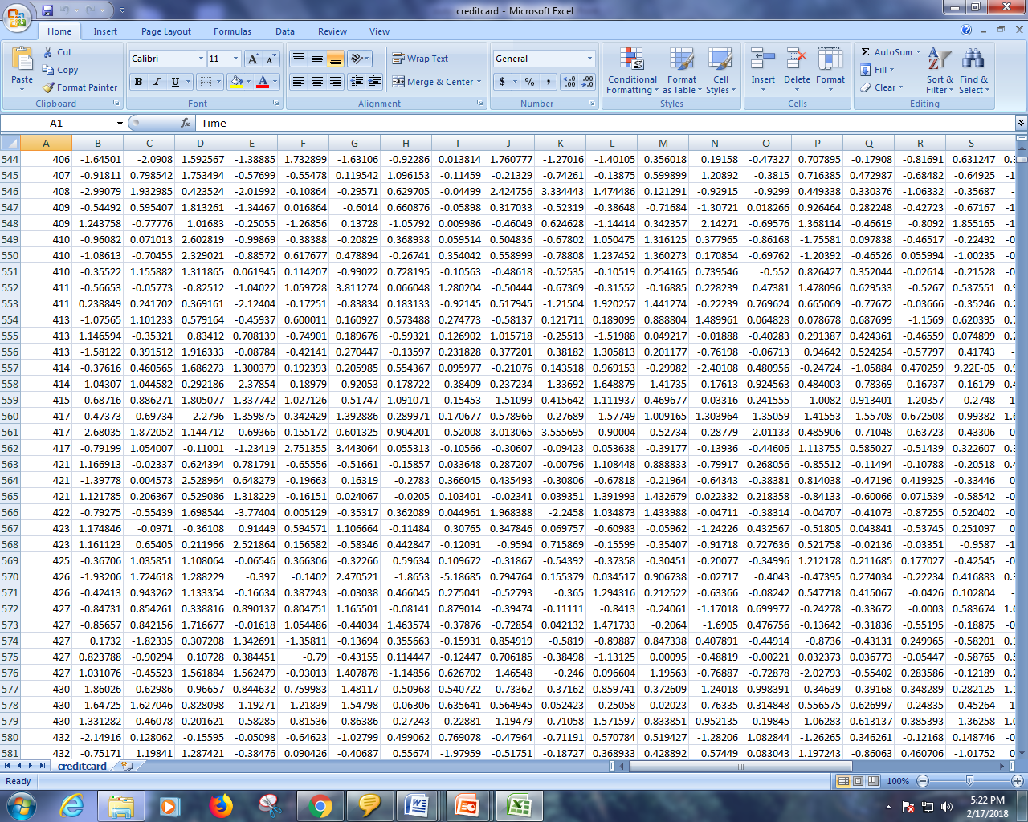

Slide 38
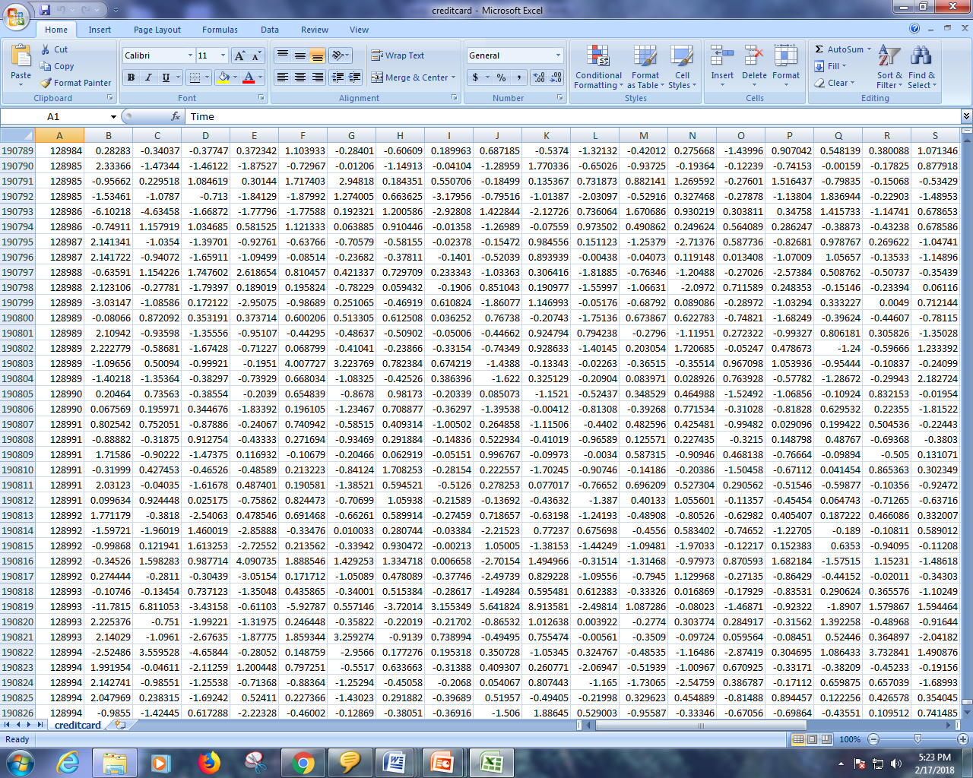

Slide 39
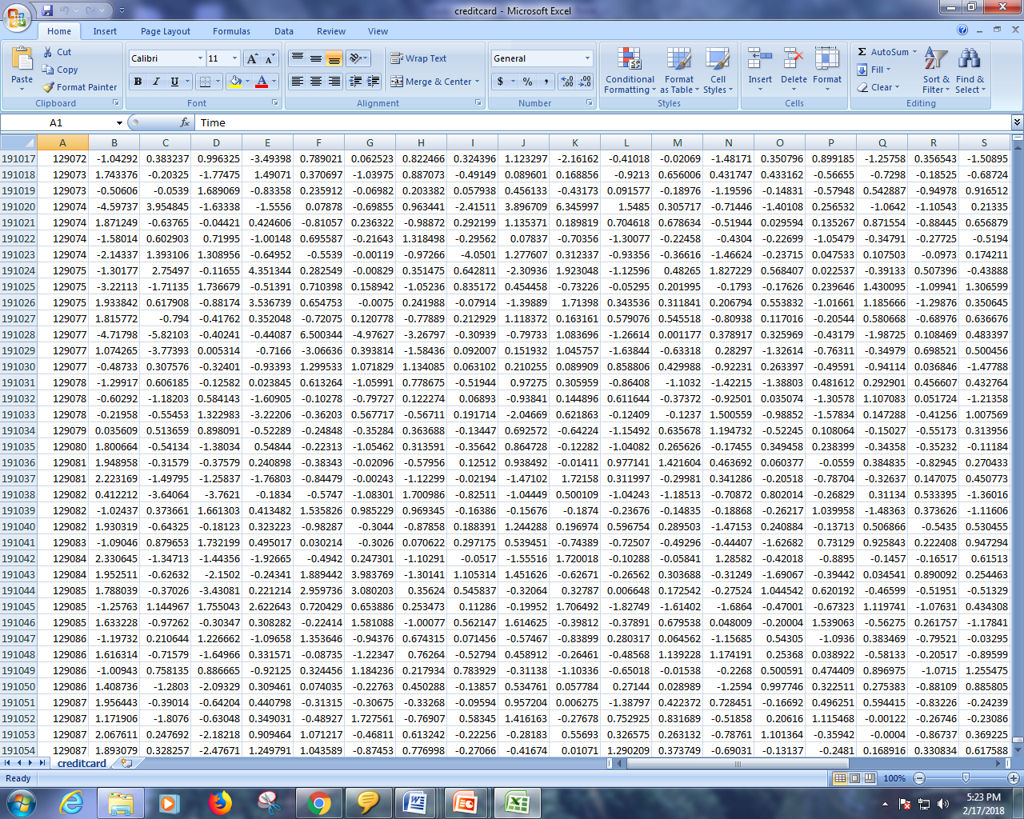

Slide 40
Algorithm

Slide 41
LOGISTIC REGRESSION
Logistic regression is a statistical method for analyzing a dataset in which there are one or more independent variables that determine an outcome. The outcome is measured with a dichotomous variable (in which there are only two possible outcomes).
Logistic regression is one of the most popular machine learning algorithms for binary classification. This is because it is a simple algorithm that performs very well on a wide range of problems.
In this post you are going to discover the logistic regression algorithm for binary classification, step-by-step. After reading this post you will know:
How to calculate the logistic function.
How to learn the coefficients for a logistic regression model using stochastic gradient descent.
How to make predictions using a logistic regression model.

Slide 42
THANK YOU

